Slide 1
VASCULAR BIOLOGY OF ATHEROMA
Dr. Madhusudan Raikar
DM Cardiology Resident
GMC, Kozhikode

Slide 2
History
The 20th century witnessed a remarkable evolution in concepts concerning the pathogenesis of atherosclerosis.
1st found in arteries of egyptian mummies.
The term atherosclerosis, which comes from the Greek words atheros (meaning “gruel” or “paste”) and sclerosis (meaning “hardness”).
Atherosclerosis became an epidemic as populations increasingly survived early mortality caused by communicable diseases and malnutrition.
Economic development and urbanization promoted habits of poor diet and diminished physical activity which favor atherosclerosis.

Slide 3
Interesting Facts
Atherosclerosis can involve both large and mid-size arteries diffusely .
Asymptomatic individuals have intimal lesions in their coronary or carotid arteries even in the early decades of life.
Why its clinical manifestations occur only at certain times?
Atherosclerosis produces focal stenoses in certain areas of affected vessels much more than in others.
Why atherosclerosis affects certain regions of the arterial tree preferentially?

Slide 4
Few human diseases have a longer “incubation” period than atherosclerosis
Despite this indolent time course, the dreaded complications of atheroma—such as MI, unstable angina, and stroke—typically occur suddenly.
Atherosclerosis also displays heterogeneity in time; this disease has both chronic and acute manifestations.
Its role in the narrowing, or stenosis, of some vessels and in the dilation, or ectasia, of others.

Slide 5
Structure Of Normal Artery
Cell Types Composing The Normal Artery :
Endothelial Cells (ECs) :
  ECs constitutes the crucial contact surface with blood.
  One of the only surfaces, either natural or synthetic, that can maintain blood in a liquid state during protracted contact .
  Partly due to expression of heparan sulfate which serves as cofactor for antithrombinIII.
  They also contain thrombomodulin, which binds thrombin molecules and can exert antithrombotic properties by activating proteins S and C.
  Possesses potent fibrinolytic mechanisms as they can produce both tissue and urokinase-type plasminogen activators.
  They have a common origin but acquire bed-specific characteristics during development because the signals they encounter during vessel development differ.

Slide 6
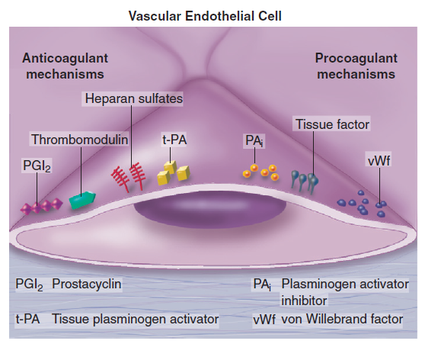

Slide 7
2. Smooth Muscle Cells (SMCs) :
  2nd major cell type of the normal arterial wall.
  These cells contract and relax and thus control blood flow through various arterial beds, generally at the level of the muscular arterioles.
  SMCs synthesizes bulk of complex arterial extracellular matrix (ECM) that plays key role in homeostasis and in formation and complication of atherosclerotic lesions.
  They can migrate and proliferate, contributing to the formation of intimal hyperplastic lesions, including atherosclerosis, restenosis, in-stent stenosis after PCI or anastomotic hyperplasia complicating vein grafts.
  Death of SMCs may promote destabilization of atheromatous plaques or favor ectatic remodeling.

Slide 8
In contrast to ECs, SMCs can arise from many sources.
Heterogeneity of SMCs may have direct clinical implications for understanding several common observations:
Propensity of certain arteries/regions of arteries to develop
  Atherosclerosis or heightened responses to injury (e.g., prox LAD)
  Medial degeneration (e.g., proximal aorta in Marfan’s disease)
Differential responses of SMCs to regulators of ECM production explains why manifestations of defects in fibrillin and elastin characteristically occur locally in Asc. aorta .

Slide 9
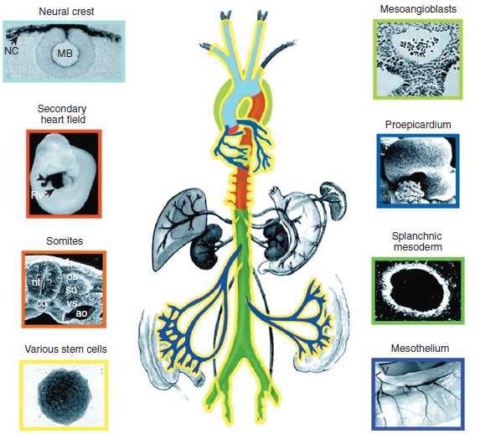
Differential Embryologic Origin Of SMCs

Slide 10
Normal arteries have a well-developed trilaminar structure .
Tunica Intima :
  This innermost layer is thin at birth.
  Often depicted as a monolayer of ECs, the structure is actually much more complex and heterogeneous.
  The endothelial monolayer resides on a basement membrane containing nonfibrillar collagen like type IV collagen, laminin, fibronectin, and other ECM molecules.
  With aging, a more complex intima containing arterial SMCs and fibrillar forms of interstitial collagen (types I and III) develops.

Slide 11
SMCs produce these ECM constituents of the arterial intima.
Some locales in the arterial tree tend to develop a thicker intima than other regions, even in the absence of atherosclerosis .
  For e.g., proximal LAD often contains an intimal cushion of SMCs more fully developed than that in typical arteries.
The diffuse intimal thickening process does not necessarily have lipid accumulation and may occur in individuals without substantial burden of atheroma.
The internal elastic membrane bounds the tunica intima abluminally and serves as the border between the intimal layer and the underlying tunica media.

Slide 12
Tunica Media :
  In elastic arteries, well-developed concentric layers of SMCs, interleaved with layers of elastin-rich ECM is present.
  This structure appears well adapted to storage of kinetic energy of LV systole by walls of great arteries.
  The lamellar structure also contributes to structural integrity of arterial trunks.
  In muscular arteries,there is a less stereotyped organization.
  SMCs in these smaller arteries generally embed in the surrounding matrix in a more continuous than lamellar array.

Slide 13
SMCs in normal arteries seldom proliferate.
In the normal artery, a state of homeostasis of ECM is present.
Because ECM neither accumulates nor atrophies, rates of arterial matrix synthesis and dissolution usually balance each other.
The external elastic lamina bounds the tunica media abluminally, forming the border with the adventitial layer.

Slide 14
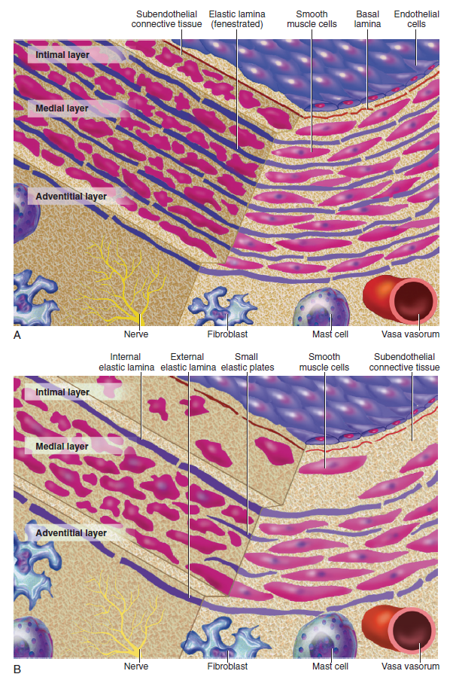

Slide 15
Tunica Adventitia :
  Contains collagen fibrils in a looser array than is usually encountered in the intima.
  Vasa vasorum and nerve endings localize in this outermost layer of the arterial wall.
  Cellular population in adventitia is sparser than in other arterial layers.
  Cells encountered in this layer include fibroblasts and mast cells.
  Emerging evidence suggests a role for mast cells in atheroma and aneurysm formation in animal models.

Slide 16
Initiation Of Atherosclerosis
Extracellular Lipid Accumulation :
small lipoprotein particles accumulate in the intima.
These lipoprotein particles bind to proteoglycan of arterial intima and tend to coalesce into aggregates .
A prolonged residence time characterizes sites of early lesion formation.
Binding of lipoproteins to proteoglycan accounts for their prolonged residence time in the intima.
Lipoprotein particles bound to proteoglycan have increased susceptibility to oxidative or other chemical modifications.
Contributors to oxidative stress in the nascent atheroma could include
  NADH/NADPH oxidases expressed by vascular cells,
  lipoxygenases expressed by infiltrating leukocytes, or
  myeloperoxidase.

Slide 17
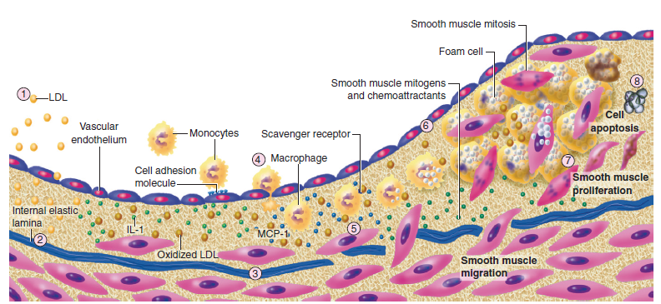
Evaluation Of Atherosclerotic Plaque

Slide 18
Leukocyte Recruitment :
Another hallmark of atherogenesis.
Normal EC generally resists adhesive interactions with leukocytes.
Even in inflamed tissues, most recruitment and trafficking of leukocytes occur in postcapillary venules and not in arteries.
Monocytes and T lymphocytes tend to accumulate in early atherosclerotic lesions.
Expression of certain leukocyte adhesion molecules on surface of EC regulates leukocyte recruitment .

Slide 19
Members of Immunoglobulin superfamily :
  VCAM-1 or CD106 - interacts with an integrin characteristically expressed by only those classes of leukocytes that accumulate in nascent atheroma.
Selectins :
  P-selectin or CD62P
Selectins tend to promote saltatory or rolling locomotion of leukocytes over endothelium.
Adhesion molecules belonging to immunoglobulin superfamily tend to promote tighter adhesive interactions and immobilization of leukocytes.

Slide 20
Directed migration of leukocytes involves action of protein molecules known as chemoattractant cytokines or chemokines.
Monocyte chemoattractant protein 1 (MCP-1) or CCL2 .
produced by endothelium in response to oxidized lipoprotein and other stimuli.
Interleukin-8 (CXCL8), binds to CXCR2 on leukocytes.
Fractalkine, a unique cell surface–bound chemokine.
Interferon-γ induces genes encoding T-cell chemoattractants

Slide 21
Focality Of Lesion Formation :
Difficult to explain as equal concentrations of blood-borne risk factors such as lipoproteins bathe endothelium throughout vasculature.
Multicentric origin hypothesis of atherogenesis, presuming that atheromas arise as benign leiomyomas of the artery wall.
The monotypia of various molecular markers in individual atheromas supports this concept.
Location of sites of lesion predilection at proximal portions of arteries after branch points or bifurcations at flow dividers, suggests a hydrodynamic basis.
Arteries without many branches (e.g., the internal mammary and radial arteries) tend not to develop atherosclerosis.

Slide 22
Two concepts can explain local flow disturbances :
  Locally disturbed flow could induce alterations that promote early atherogenesis.
  Laminar flow that usually prevails at sites that do not tend to develop early lesions may elicit antiatherogenic homeostatic mechanisms (atheroprotective functions).
In vitro data suggest that laminar shear stress can augment expression of genes that may protect against atherosclerosis, like enzymes superoxide dismutase and nitric oxide synthase.

Slide 23
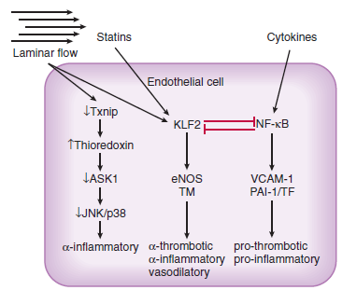

Slide 24
Intracellular Lipid Accumulation – Foam Cell Formation :
The monocyte, once recruited to arterial intima, can imbibe lipid and become a foam cell or lipid-laden macrophage.
Most cells can express the classic cell surface receptor for LDL, but these receptor do not mediate foam cell accumulation.
Pts. lacking functional LDL receptors (familial hypercholesterolemia homozygotes) still develop tendinous xanthomas filled with foamy macrophages.
Scavenger receptors appear to mediate excessive lipid uptake characteristic of foam cell formation.
These surface molecules bind modified rather than native lipoproteins and participate in their internalization.

Slide 25
Other receptors that may participate in foam cell formation include CD36 and macrosialin, which exhibit preferential binding to oxidized forms of LDL.
Once macrophages become foam cells, they can replicate.
The factors that trigger macrophage cell division probably include M-CSF.
Other candidates for macrophage mitogens or co-mitogens include IL-3 and GM-CSF.

Slide 26
Evolution Of Atheroma
Mechanisms of Inflammation in Atheroma – Innate and Adaptive Immunity :
Fundamental role of inflammation in atherogenesis.
The macrophage foam cells in established atherosclerotic lesion, are rich source of proinflammatory mediators.
These phagocytic cells also elaborate large quantities of oxidant species, such as superoxide anion, thus contribute to progression of lesions.
The term innate immunity describes this type of amplification of the inflammatory response that does not depend on antigenic stimulation.

Slide 27
In addition, dendritic cells in atherosclerotic lesions can present antigens to T cells that constitute an important minority of the leukocytes in atherosclerotic lesions.
Candidate antigens for stimulation of this adaptive immune response include modified lipoproteins, heat shock proteins, beta₂-glycoprotein I b, and infectious agents.
Activated T cells then can secrete copious quantities of cytokines that can modulate atherogenesis.

Slide 28
SMC Migration and Proliferation :
Few SMCs probably arrive in arterial intima early in life, others accumulate in advancing atheroma after recruitment from the underlying media or arise from blood-borne precursors.
Chemoattractants for SMCs likely include molecules such as platelet-derived growth factor (PDGF).
SMCs in atherosclerotic intima can also multiply by cell division.
Estimated rates of division of SMCs in atherosclerotic lesions is less than 1%.
But even such indolent replication might yield considerable SMC accumulation during decades of lesion evolution.

Slide 29
SMCs in the normal arterial tunica media differ considerably from those in the intima of an evolving atheroma.
SMCs in the atherosclerotic intima appear to exhibit a less mature phenotype than the quiescent SMCs in the normal arterial medial layer.
These SMCs in the intima have higher levels of the embryonic isoform of smooth muscle myosin.
These intimal SMCs in atheroma appear morphologically distinct as well.
They contain more rough endoplasmic reticulum and fewer contractile fibers than do normal medial SMCs.

Slide 30
Accumulation of SMCs during atherosclerosis and growth of the intima may not occur in a continuous and linear fashion.
Rather, “crises” may punctuate the history of an atheroma, during which bursts of smooth muscle replication or migration may occur.
In addition to SMC replication, death of these cells may also participate in complication of atherosclerotic plaque.
Apoptosis may occur in response to inflammatory cytokines present in the evolving atheroma.
Thus, SMC accumulation in growing atherosclerotic plaque probably results from a tug-of-war between cell replication and cell death.

Slide 31
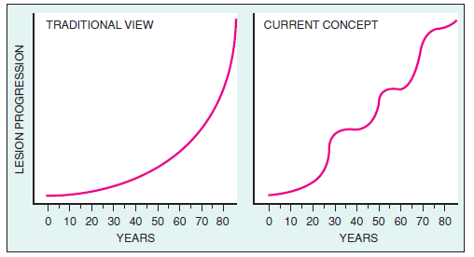

Slide 32
Arterial ECM :
ECM makes much of the volume of an advanced atherosclerotic plaque.
The major ECM macromolecules that accumulate in atheroma include interstitial collagens (types I and III) and proteoglycans such as versican, biglycan, aggrecan, and decorin.
Elastin fibers may also accumulate in atherosclerotic plaques.
Arterial SMCs produce these matrix molecules.

Slide 33
Stimuli for excessive collagen production by SMCs include PDGF and TGF-β.
ECM secretion also depends on a balance between formation and breakdown.
ECM molecules break down is catalyzed in part by catabolic enzymes known as matrix metalloproteinases (MMPs).
Dissolution of ECM macromolecules undoubtedly plays a role in migration of SMCs, traversing the elastin-rich internal elastic lamina.

Slide 34
ECM breakdown also plays a role in arterial remodeling that accompanies lesion growth.
During the early life of an atheromatous lesion, plaques grow outwardly, in an abluminal direction.
This outward growth of the intima leads to an increase in caliber of entire artery.
This so-called positive remodeling or compensatory enlargement must involve turnover of ECM molecules to accommodate circumferential growth of artery.
Luminal stenosis tends to occur only after plaque burden exceeds some 40% of cross-sectional area of artery.

Slide 35
Angiogenesis in Plaques :
Atherosclerotic plaques develop their own microcirculation as they grow.
These microvessels probably form in response to angiogenic peptides overexpressed in atheroma like vascular endothelial growth factor (VEGF), forms of fibroblast growth factors, placental growth factor (PlGF), and oncostatin M.
These microvessels within plaques probably have considerable functional significance.
They provide a relatively large surface area for trafficking of leukocytes.

Slide 36
This microvascular endothelium displays VCAM-1 much more prominently than does the macrovascular endothelium overlying the plaque.
They may also allow growth of plaque, overcoming diffusion limitations on oxygen and nutrient supply, in analogy with concept of tumor angiogenic factors and growth of malignant lesions.
These microvessels may be friable and prone to rupture.
Hemorrhage and thrombosis in situ could promote a local round of SMC proliferation and matrix accumulation.

Slide 37
Plaque Mineralization :
Plaques often develop areas of calcification as they evolve.
Atheroma calcification shares many mechanisms with bone formation.
Receptor activator of NF-κB ligand (RANKL), a member of TNF family, appears to promote SMC mineral formation through a bone morphogenetic protein 4 (BMP4) –dependent pathway.
Osteoprotegerin can antagonize plaque mineralization by inhibiting RANKL signaling.

Slide 38
Complications Of Atherosclerosis
Arterial Stenosis and their Consequences :
After plaque burden exceeds the capacity of artery to remodel outward, encroachment on arterial lumen begins.
Lesions that produce stenoses of > 60% can cause flow limitations under conditions of increased demand.
This type of athero-occlusive disease commonly produces chronic stable angina or intermittent claudication .
Thrombosis, complicating a non occlusive plaque, most often causes episodes of unstable angina or acute MI

Slide 39
These findings do not imply that small atheromas cause most MIs.
Indeed, culprit lesions of acute MI may be sizeable; but they may not produce a critical luminal narrowing because of compensatory enlargement.
High -grade stenoses more likely cause acute MI than do non occlusive lesions.
Since the non critical stenoses outnumber tight focal lesions in a given coronary tree, the lesser stenoses cause more infarctions even though high-grade stenoses have a greater individual probability of causing MIs.

Slide 40
Thrombosis and Atheroma Complication :
critical mechanism for transition from chronic to acute atherosclerosis.
A physical disruption of the atherosclerotic plaque commonly causes acute thrombosis.
Plaque Rupture and Thrombosis :
Accounts for 2/3 cases of acute MI.
Reflects an imbalance between forces that impinge on plaque’s cap and mechanical strength of fibrous cap.

Slide 41
Interstitial forms of collagen provide most of biomechanical resistance to disruption of fibrous cap.
Hence, metabolism of collagen probably participates in regulating the propensity of a plaque to rupture.
Factors that decrease collagen synthesis by SMCs can impair their ability to repair and to maintain the plaque’s fibrous cap.
Thinning of the plaque’s fibrous cap, explains why they are prone to rupture and cause fatal MI.
Another feature of the so-called vulnerable atherosclerotic plaque defined by pathologic analysis is a relative lack of SMCs.

Slide 42
A prominent accumulation of macrophages and a large lipid pool is a third microanatomic feature of the so-called vulnerable atherosclerotic plaque.
A large lipid pool can serve to concentrate biomechanical forces on shoulder regions of plaques, which are common sites of rupture of fibrous cap.
Activated macrophage produces the cytokines and the matrix-degrading enzymes.
Apoptotic macrophages and SMCs can generate particulate tissue factor, a potential instigator of microvascular thrombosis after spontaneous or iatrogenic plaque disruption.
The success of lipid-lowering therapy relates to reduced accumulation of lipid and a decrease in inflammation and plaque thrombogenicity.

Slide 43
Superficial Erosion of Plaques :
Accounts for upto a 1/4 cases of acute MI.
The pathobiology is much less understood.
More likely to cause fatal acute MI in women and in individuals with hypertriglyceridemia and DM.
Apoptosis of ECs could contribute to desquamation of ECs in areas of superficial erosion.
MMPs, such as gelatinases might degrade nonfibrillar collagen of basement membrane and sever tetherings of EC and promote their desquamation.
Most plaque disruptions do not give rise to clinically apparent coronary events.
Plaque disruptions with healing underlie many thrombi that cause sudden death, indicating that nonocclusive thrombosis may precede the mortal event.

Slide 44
Diffue and Systemic Nature of Plaque Vulnerability :
Studies at autopsy of atherosclerotic plaques that caused fatal thrombosis brought notion of vulnerable high-risk plaque.
Current evidence suggests that more than one such high-risk plaque often resides in a given coronary tree.
There is an asso of lesions that cause acute manifestations (“culprit lesions”) with positive remodeling or compensatory enlargement of arteries.
Inflammation precedes the acute coronary syndrome.
Inflammation thought to characterize the so-called vulnerable plaque appears widespread.
Various systemic markers of inflammation, such as C-reactive protein, increase in patients at risk for ACS.

Slide 45
This has important therapeutic implications such that, in addition to appropriately deployed local revascularization strategies, individuals should also receive systemic therapy aimed at stabilizing the usually multiple high-risk lesions that may cause recurrent events.
Thrombosis depends not only on the “solid state” of the plaque that may rupture or erode to trigger thrombosis, but also on the “fluid phase” of blood that determines the consequences of a given plaque disruption.
Level of fibrinogen in the fluid phase of blood can influence whether a plaque disruption will cause an occlusive thrombus or merely a small mural thrombus.
levels of inhibitors of fibrinolysis, such as PAI-1, will impede the ability of endogenous plasminogen activator to limit thrombus growth or persistence.
Inflammation regulates both the fluid-phase and solid-state factors .

Slide 46
Special Cases Of Arteriosclerosis
Restenosis after Arterial Intervention :
Restenosis and In-stent Restenosis (ISR) after PCI represent special cases of arterial hyperplastic disease.
IVUS studies suggested that a substantial proportion of loss of luminal caliber after balloon angioplasty resulted from a constriction of vessel from adventitial side (negative remodeling).
These observations renewed interest in adventitial inflammation, with scar formation and wound contraction as a mechanism of arterial constriction after balloon angioplasty.
Widespread use of stents has changed the face of the restenosis problem.

Slide 47
ISR, in contrast to restenosis, depends uniquely on intimal thickening.
Histologic analyses reveal that a much of the volume of ISR lesion is made up of “myxomatous” tissue, comprising occasional stellate SMCs embedded in a loose and highly hydrated ECM.
Currently, DES have shown great benefit in preventing ISR, but with an increased risk of late stent thrombosis.
The risk of late thrombosis after radiation brachytherapy or DES may relate to impaired endothelial healing, with the attendant loss of anticoagulant and profibrinolytic properties of normal intimal lining.

Slide 48
Accelerated Arteriosclerosis after Transplantation :
After advent of effective immunosuppressive therapy, the major limitation to long-term survival of cardiac allografts is development of an accelerated form of arterial hyperplastic disease.
Often presents a diagnostic challenge.
Pt. may not experience typical anginal symptoms because of post-transplantation cardiac denervation.
Graft coronary disease is concentric and diffuse, not only affecting the proximal epicardial coronary vessels but also penetrating smaller intramyocardial branches.
Coronary angiogram consistently underestimates the degree of transplantation arteriosclerosis.

Slide 49
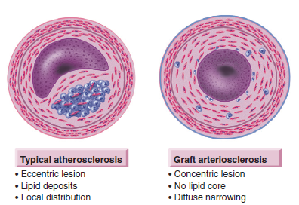

Slide 50
Even in absence of traditional risk factors, there is risk for development of accelerated arteriosclerosis.
Suggests that pathophysiology of this form of accelerated arteriosclerosis differs from that of typical atherosclerosis.
Selective involvement of engrafted vessels, suggests that immunologic differences between the host and recipient vessels might contribute to pathogenesis of this disease.
At the other extreme, patients with homozygous familial hypercholesterolemia can develop fatal atherosclerosis in the first decade of life solely as a result of an elevation in LDL.
Analysis of usual atherosclerotic lesions shows evidence for a chronic immune response and lipid accumulation.

Slide 51
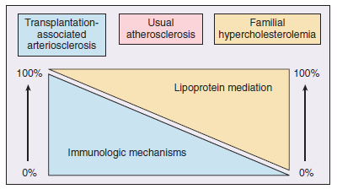

Slide 52
Aneurysmal Disease :
Atherosclerosis also produces aneurysmal disease.
In particular, aneurysmal disease characteristically affects infrarenal abdominal aorta.
Because of absence of vasa vasorum, relative lack of blood supply to tunica media in this portion of the abdominal aorta might explain the regional susceptibility.
Lumbar lordosis may alter the hydrodynamics of blood flow in the distal aorta, yielding flow disturbances that may promote lesion formation.

Slide 53
Transmural destruction of the arterial architecture occurs in aneurysmal disease.
Medial SMCs, usually well preserved in typical stenotic lesions, are notable for their paucity in media of advanced aortic aneurysms.
Widespread destruction of elastic laminae suggests a role for degradation of elastin, collagen, and other constituents of the arterial ECM.
Aortic aneurysms also show evidence for considerable inflammation, particularly in the adventitia.

Slide 54
THANK YOU

